Slide 1
Waves and Sound
Physics
Unit 7
Notes:
Physics Unit 7

Slide 2
This Slideshow was developed to accompany the textbook
  OpenStax Physics
    Available for free at https://openstaxcollege.org/textbooks/college-physics
  By OpenStax College and Rice University
  2013 edition
Some examples and diagrams are taken from the textbook.
Slides created by
Richard Wright, Andrews Academy
rwright@andrews.edu

Slide 3
07-01 Waves
In this lesson you will…
• State the characteristics of a wave.
• Calculate the velocity of wave propagation.
• Observe the vibrations of a guitar string.
• Determine the frequency of oscillations.

Slide 4
07-01 Waves
Waves
A traveling disturbance
Carries energy from place to place
When a boat makes a wave,
  the water itself does not get up and move
  the water pushes a little, then moves back
  energy is transferred in the wave and is what you feel
Notes:
If the water moved in bulk, then there would be a hole in the water.

Slide 5
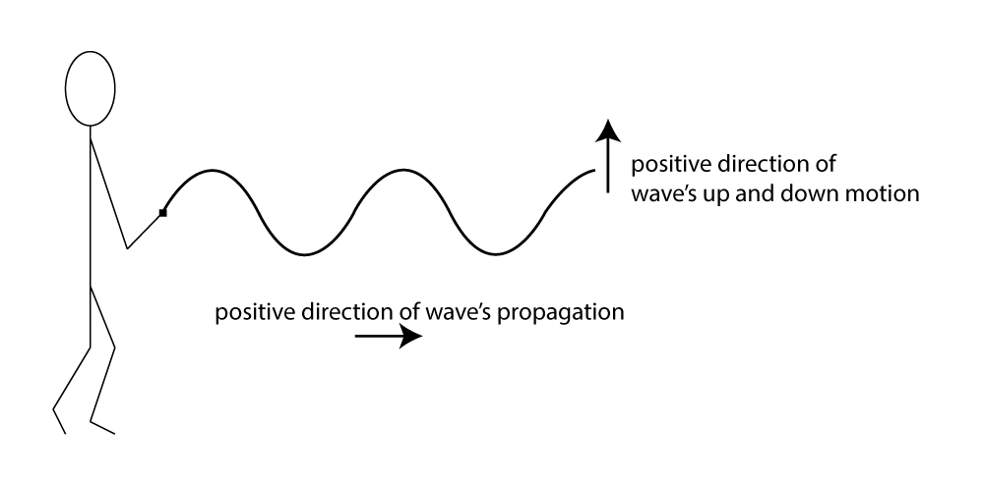
07-01 Waves
Transverse
  Up and down disturbance
  Wave travels left or right
  Disturbance is perpendicular to direction of travel
  Examples:
    Radio waves, light waves, microwaves, stringed instruments
Notes:
Demonstrate with a slinky

Slide 6
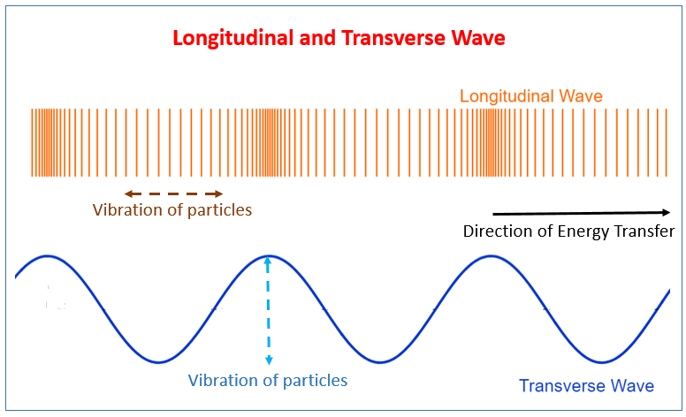
07-01 Waves
Longitudinal Waves
  Disturbance is left and right
  Direction of travel is left or right
  Disturbance and direction of travel are parallel
  Series of compressed and stretched regions
  Example:
    Sound
Notes:
Demonstrate with a slinky

Slide 7
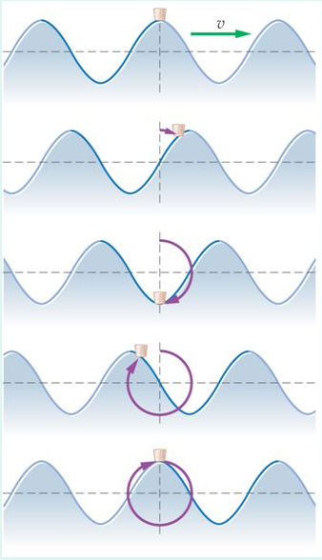
07-01 Waves
Other
  Water waves are a combination
  Water at the surface of a water wave travels in small circles

Slide 8
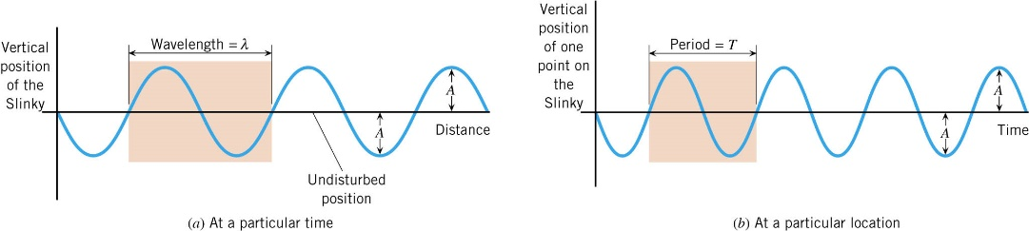
07-01 Waves
Periodic → pattern is regularly repeated
Cycle → one unit of pattern
Wavelength (λ) → Distance of one cycle
Amplitude (A) → height from equilibrium to crest
Notes:
Put drawing on board and label the parts
The amplitude of a longitudinal wave is the amount of compression instead of a height

Slide 9

07-01 Waves
Period (T) → time it takes for one cycle
  Unit: s
Frequency (f) → # of cycles per second
  Unit: 1/s = 1 hertz (Hz)
$f=\frac{1}{T}$
$v=\frac{λ}{T}=f⋅λ$

Slide 10
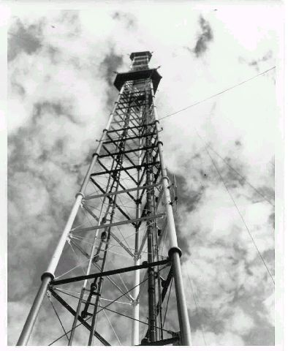
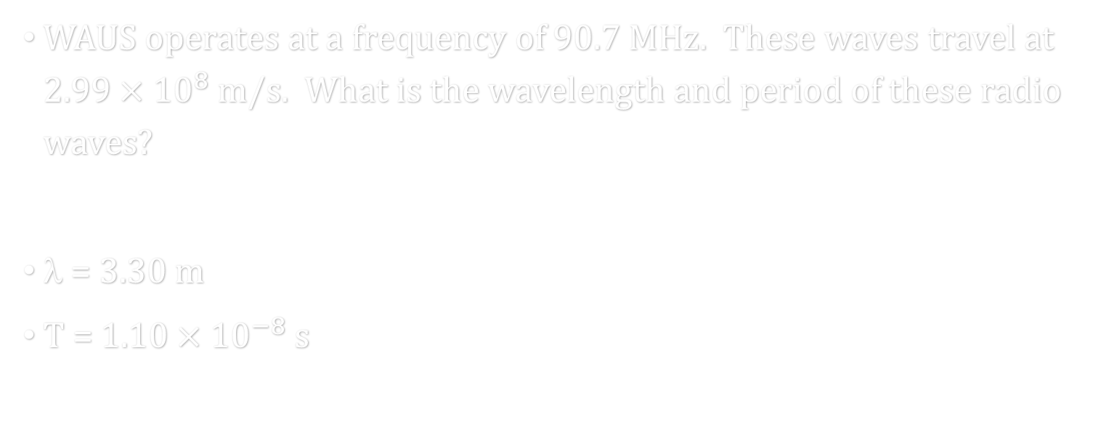
07-01 Waves
WAUS operates at a frequency of 90.7 MHz. These waves travel at $2.99×{10}^{8}$ m/s. What is the wavelength and period of these radio waves?
λ = 3.30 m
T = $1.10×{10}^{−8}$ s
Notes:
$$v = f$$
$$2.99×{10}^{8}\frac{m}{s}=90.7×{10}^{6} Hz $$
$$=3.30 m$$
$$f=\frac{1}{T} → 90.7×{10}^{6} Hz=\frac{1}{T} → T=\frac{1}{90.7×{10}^{6} Hz}=1.10×{10}^{−8} s$$

Slide 11

07-01 Waves
You are sitting on the beach and notice that a seagull floating on the water moves up and down 15 times in 1 minute. What is the frequency of the water waves?
f = 0.25 Hz
Notes:
$$Frequency is\frac{cycles}{seconds}$$
$$f=\frac{15}{60 s}=0.25 Hz$$

Slide 12
07-01 Homework
Wave hello to some exercises.
Read 16.1, 16.3

Slide 13
07-02 Hooke’s Law and Simple Harmonic Motion
In this lesson you will…
• Explain Newton’s third law of motion with respect to stress and deformation.
• Describe the restoration of force and displacement.
• Calculate the energy in Hook’s Law of deformation, and the stored energy in a string.
• Describe a simple harmonic oscillator.
• Explain the link between simple harmonic motion and waves.

Slide 14
07-02 Lab
Do the 07-02 Simple Harmonic Motion Lab

Slide 15
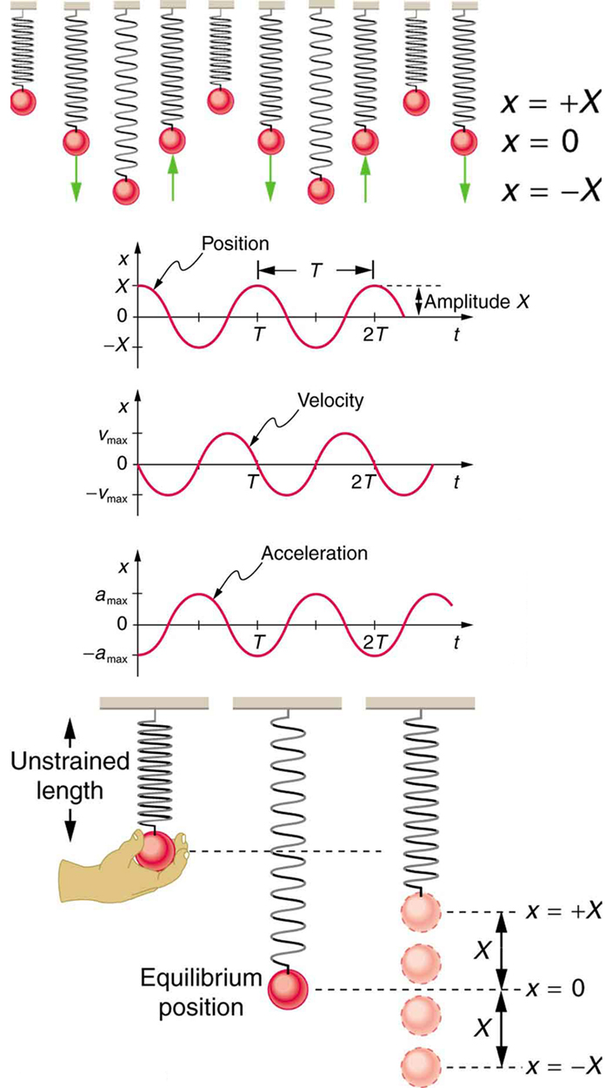
07-02 Hooke’s Law and Simple Harmonic Motion
A mass is hung from a spring
If it just hangs, it is at equilibrium position
If stretched and released, it bounced up and down

Slide 16
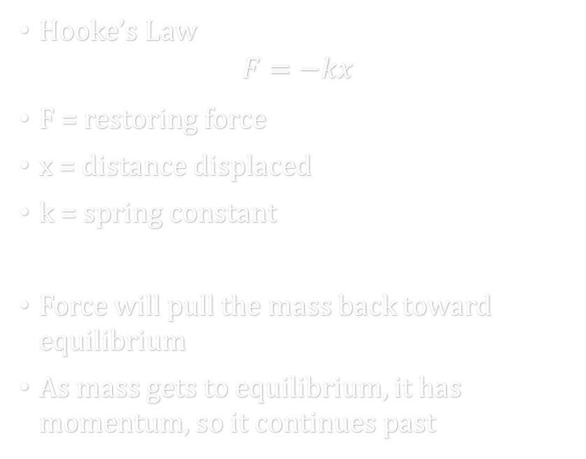
07-02 Hooke’s Law and Simple Harmonic Motion
Hooke’s Law
$$F=−kx$$
F = restoring force
x = distance displaced
k = spring constant
Force will pull the mass back toward equilibrium
As mass gets to equilibrium, it has momentum, so it continues past

Slide 17

07-02 Hooke’s Law and Simple Harmonic Motion
Energy in Hooke’s Law
  Since a force acts over a distance, work is done
  $$PE_{el}=\frac{1}{2}kx^{2}$$
Notes:
Called elastic potential energy

Slide 18

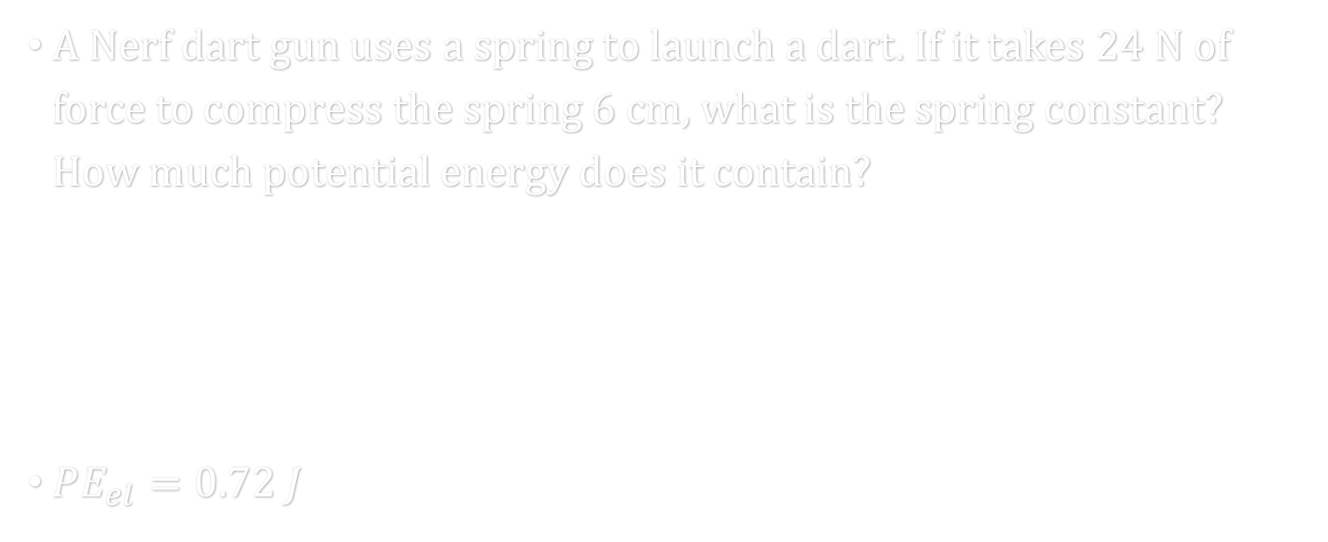
07-02 Hooke’s Law and Simple Harmonic Motion
A Nerf dart gun uses a spring to launch a dart. If it takes 24 N of force to compress the spring 6 cm, what is the spring constant? How much potential energy does it contain?
$PE_{el}=0.72 J$
Notes:
$$F=−kx$$
$$24 N=−k\left(−0.06 m\right)$$
$$k=400\frac{N}{m}$$
$$PE_{el}=\frac{1}{2}kx^{2}$$
$$PE_{el}=\frac{1}{2}\left(400\frac{N}{m}\right){\left(0.06 m\right)}^{2}$$
$$PE_{el}=0.72 J$$

Slide 19
07-02 Hooke’s Law and Simple Harmonic Motion
On a string, if one part of the string is pulled up (a wave pulse created),
  Then the next piece of the string is pulled up
  Then the next piece of the string is pulled up, etc.
  After the pulse passed the string moves back down to the equilibrium position due to Hooke’s Law
  The more force, the quicker the string accelerates back and the faster the wave travels.

Slide 20

07-02 Hooke’s Law and Simple Harmonic Motion
Speed of a Wave on a String
Speed of a wave depends on the medium
For a string, the speed depends on
  Tension
  Linear density (m/L)
$$v=\sqrt{\frac{F}{m/L}}$$

Slide 21
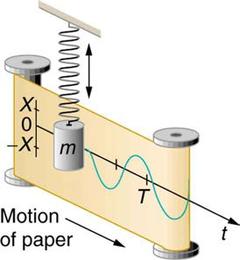
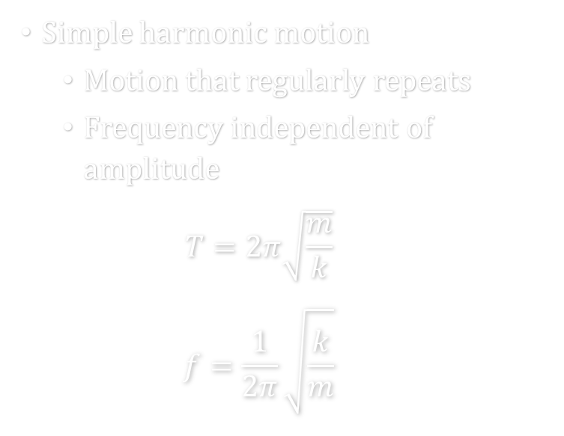
07-02 Hooke’s Law and Simple Harmonic Motion
Simple harmonic motion
  Motion that regularly repeats
  Frequency independent of amplitude
  $$T=2π\sqrt{\frac{m}{k}}$$
  $$f=\frac{1}{2π}\sqrt{\frac{k}{m}}$$
If a graph of position versus time of simple harmonic motion is made, a wave is formed

Slide 22
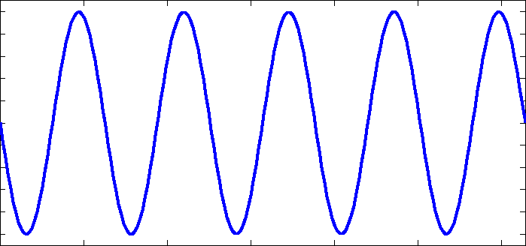
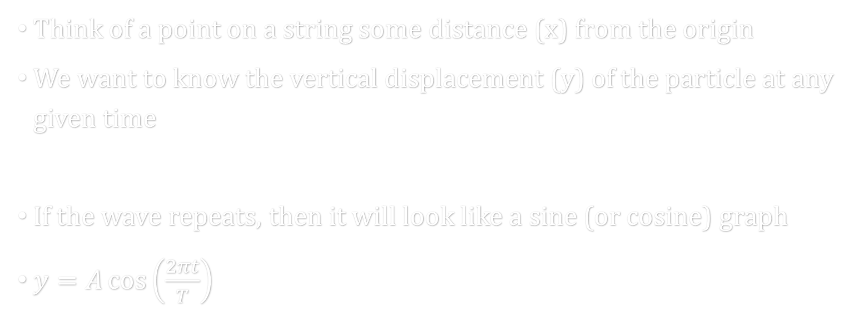
07-02 Hooke’s Law and Simple Harmonic Motion
Think of a point on a string some distance (x) from the origin
We want to know the vertical displacement (y) of the particle at any given time
If the wave repeats, then it will look like a sine (or cosine) graph
$y=A\cos\left(\frac{2πt}{T}\right)$

Slide 23
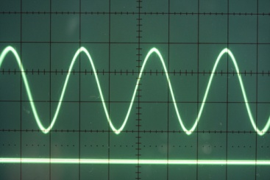

07-02 Hooke’s Law and Simple Harmonic Motion
A wave has an amplitude of 1.5 cm, a speed of 20 m/s, and a frequency of 100 Hz. Write the equation of the wave position of the wave.
$y=0.015\cos{(200πt)}$
Notes:
$$y=A cos(2πt/T)$$
$$A = 0.015 m$$
$$f = 100 Hz→T=\frac{1}{100 Hz}=0.01 s$$
$$y=0.015\cos\left(\frac{2πt}{0.01 s}\right)$$
$$y=0.015\cos{(200πt)}$$

Slide 24
07-02 Homework
These problems harmonize with the lesson
Read 17.1, 17.2

Slide 25
07-03 Sound, Speed, Frequency, and Wavelength
In this lesson you will…
• Define sound and hearing.
• Describe sound as a longitudinal wave.
• Define pitch.
• Describe the relationship between the speed of sound, its frequency, and its wavelength.
• Describe the effects on the speed of sound as it travels through various media.
• Describe the effects of temperature on the speed of sound.

Slide 26
07-03 Lab
Do the 07-03 Properties of Sound Lab

Slide 27
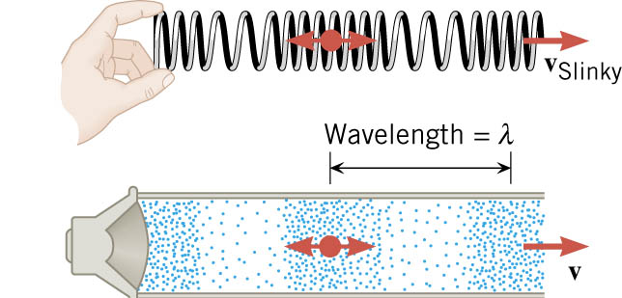
07-03 Sound, Speed, Frequency, and Wavelength
How sound is made
  Some vibrating object like a speaker moves and compresses the air
  Air pressure rises called Condensation
  Condensation moves away at speed of sound
  Object moves back creating less air pressure called Rarefaction
  Rarefaction moves away at speed of sound
  Particles move back and forth
Notes:
Maybe have big speaker with bouncing something on it

Slide 28
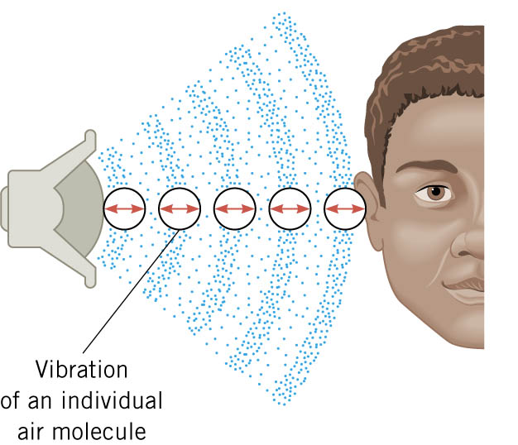
07-03 Sound, Speed, Frequency, and Wavelength
Distance between consecutive condensations or rarefactions is wavelength
String or speaker makes air molecule vibrate
That molecule pushes the next one to vibrate and so on
When it hits the ear, the vibrations are interpreted as sound

Slide 29
07-03 Sound, Speed, Frequency, and Wavelength
1 cycle = 1 condensation + 1 rarefaction
Frequency = cycles / second
1000 Hz = 1000 cycles / second
Each frequency has own tone
  Sounds with 1 frequency called Pure Tone
Healthy young people can hear frequencies of 20 to 20,000 Hz

Slide 30
07-03 Sound, Speed, Frequency, and Wavelength
Brain can interpret frequency as pitch
  High freq = high pitch
  Subjective because most people don’t have perfect pitch
Some electronic devices can produce and detect exact frequencies

Slide 31
07-03 Sound, Speed, Frequency, and Wavelength
The condensations have more pressure than the rarefactions
Amplitude = highest pressure
Typical conversation, Amp = 0.03 Pa
Atmospheric air pressure = 101,000 Pa
Loudness is ear’s interpretation of pressure amplitude
Notes:
Loudness is subjective, pressure is not.
Measure pressure to see if damaging

Slide 32

07-03 Sound, Speed, Frequency, and Wavelength
For all waves
$$v_{w}=fλ$$
Sound travels slowest in gases, faster in liquids, and fastest in solids
Air at 20 $°C$ → 343 m/s
Fresh Water → 1482 m/s
Steel → 5960 m/s

Slide 33
07-03 Sound, Speed, Frequency, and Wavelength
Speed of sound depends on properties of medium
In gases
  Sound is transmitted only when molecules collide
  So we derive formula from speed of molecules
    And speed changes with temperature

Slide 34

07-03 Sound, Speed, Frequency, and Wavelength
For air
$$v_{w}=\left(331\frac{m}{s}\right)\sqrt{\frac{T}{273 K}}$$
  where T is in Kelvin

Slide 35

07-03 Sound, Speed, Frequency, and Wavelength
What wavelength corresponds to a frequency of concert A which is 440 Hz if the air is 25 °C?
$λ=0.786 m$
Notes:
$$T=25 °C=298 K$$
$$v_{w}=\left(331\frac{m}{s}\right)\sqrt{\frac{T}{273 K}}$$
$$v_{w}=\left(331\frac{m}{s}\right)\sqrt{\frac{298 K}{273 K}}=345.8\frac{m}{s}$$
$$v_{w}=fλ$$
$$345.8\frac{m}{s}=440 Hz λ$$
$$λ=0.786 m$$

Slide 36
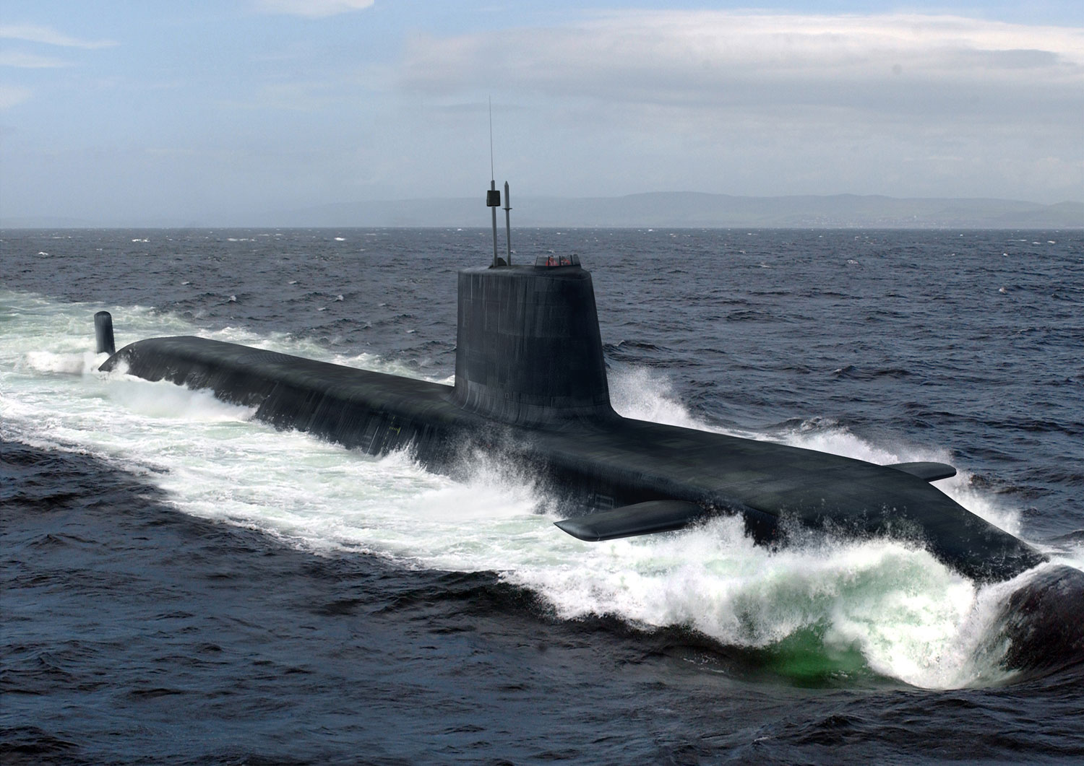
07-03 Sound, Speed, Frequency, and Wavelength
Sonar (Sound Navigation Ranging)
Sound is emitted from the hull of a ship.
It bounces off some object.
The echo returns to a receiver on the hull of the ship
How far away is a ship if it takes 3.4 s to receive a return signal in seawater?
  d = 2618 m
Notes:
$$v=1540 m/s$$
$$x=vt→x=\left(1540\frac{m}{s}\right)\left(3.4 s\right)→x=5236 m$$
This the distance to the object and back again. So divide it by 2 → $x=2618 m$

Slide 37
07-03 Homework
These problems sound like you could speed right through them.
Read 17.3

Slide 38
07-04 Sound Intensity and Sound Level
In this lesson you will…
• Define intensity, sound intensity, and sound pressure level.
• Calculate sound intensity levels in decibels (dB).

Slide 39
07-04 Lab
Do the 07-04 Intensity vs Distance Lab

Slide 40
07-04 Sound Intensity and Sound Level
Sound waves carry energy that can do work
Amount of energy transported per second = power
Units: J/s = W
Notes:
Work example causing ear drum to vibrate

Slide 41
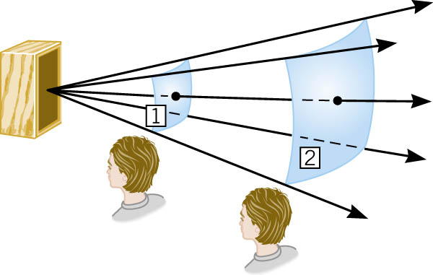
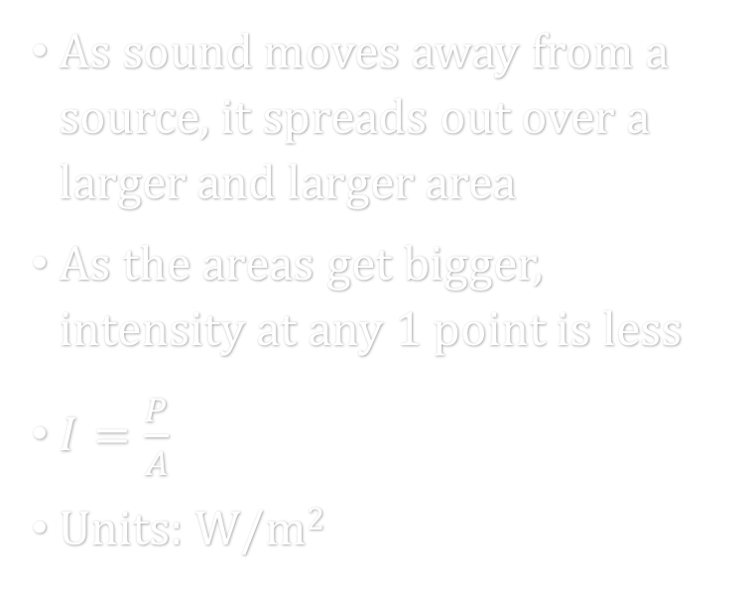
07-04 Sound Intensity and Sound Level
As sound moves away from a source, it spreads out over a larger and larger area
As the areas get bigger, intensity at any 1 point is less
$I=\frac{P}{A}$
Units: W/m²

Slide 42
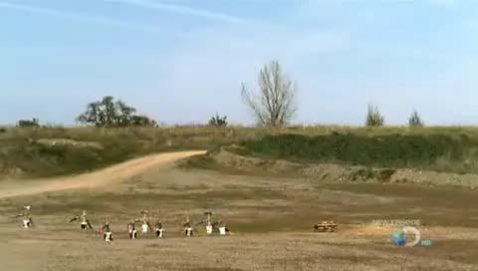
07-04 Sound Intensity and Sound Level

Slide 43

07-04 Sound Intensity and Sound Level
If sound is transmitted uniformly in all directions, the areas are the surfaces of spheres.
$A_{sphere}=4πr^{2}$
$I_{uniform}=\frac{P}{4πr^{2}}$
Notes:
Notice that Intensity ∝ 1 / r²
As distance doubles, the intensity is divided by four

Slide 44

07-04 Sound Intensity and Sound Level
Intensity is proportional to amplitude²
$$I=\frac{{\left(Δp\right)}^{2}}{2ρv_{w}}$$
  where
    $Δp$ = pressure amplitude
    $ρ$ = density of the medium
    $v_{w}$ = speed of the wave
Notes:
Used lowercase p for Pressure to keep from confusing with Power

Slide 45
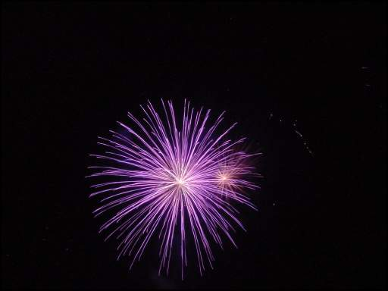

07-04 Sound Intensity and Sound Level
You and a friend are watching fireworks that are launching from the observatory. You are standing right in front of University Towers (150 m) and your friend is across campus at AA (700 m). The sound intensity at AA is 0.2 W/m². What is the sound intensity at your location, and how much power is the firework emitting?
P = $1.23×{10}^{6}$W
I = 4.36 W/m²
Notes:
$$I=\frac{P}{A}$$
$$0.2\frac{W}{m^{2}}=\frac{P}{4π{\left(700 m\right)}^{2}}→ P=1.231504×{10}^{6} W$$
$$I=\frac{P}{A}$$
$$I=\frac{1.23×{10}^{7} W}{4π{\left(150 m\right)}^{2}}=4.36 W/m^{2}$$
$$Sitting out by berman hall during the fireworks at the beginning of the school year. Some of the sounds were so strong that they made my jacket visibly move$$

Slide 46
07-04 Sound Intensity and Sound Level
Sound Level and Decibels
Unit of measure to compare two sound intensities.
Based on how human ear perceives loudness.
If you double the intensity, I, the sound isn’t twice as loud.
Use a logarithmic scale

Slide 47
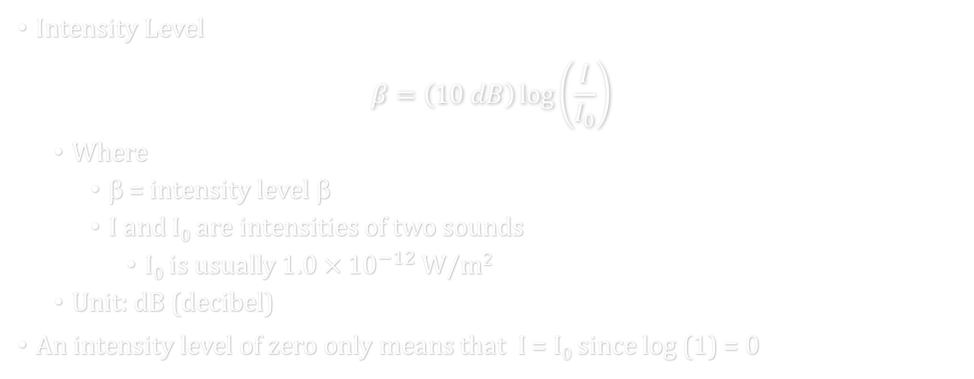
07-04 Sound Intensity and Sound Level
Intensity Level
$$β=\left(10 dB\right)\log\left(\frac{I}{I_{0}}\right)$$
  Where
    β = intensity level β
    I and I₀ are intensities of two sounds
      I₀ is usually $1.0×{10}^{−12}$W/m²
  Unit: dB (decibel)
An intensity level of zero only means that I = I₀ since log (1) = 0
Notes:
I₀ is the threshold of hearing

Slide 48
07-04 Sound Intensity and Sound Level
Intensity can be measured
Loudness is simply how ear perceives
Doubling intensity does not double loudness

Slide 49
07-04 Sound Intensity and Sound Level
You double the intensity of sound coming from a stereo. What is the change in loudness?
β = 3 dB
Experiment shows that if the intensity level increases by 10 dB, the sound will seem twice as loud.
See Table 17.2
Notes:
$$β=\left(10 dB\right)\log\left(\frac{I}{I_{0}}\right)$$
$$β=\left(10 dB\right)\log\left(\frac{2I}{I}\right)$$
$$β=\left(10 dB\right)\log{2}$$
$$β≈3 dB$$
Thus a 200 W stereo system will only sound twice as loud as a 20 W system.

Slide 50

07-04 Sound Intensity and Sound Level
What is the intensity of a 20 dB sound?
$I={10}^{−10} W/m^{2}$
Notes:
$$β=\left(10 dB\right)\log\left(\frac{I}{I_{0}}\right)$$
$$20 db=\left(10 dB\right)\log\left(\frac{I}{{10}^{−12} W/m^{2}}\right)$$
$$2=\log\left(\frac{I}{{10}^{−12} W/m^{2}}\right)$$
$${10}^{2}=\frac{I}{{10}^{−12} W/m^{2}}$$
$$I={10}^{−10} W/m^{2}$$

Slide 51
07-04 Homework
This is intense!
Read 17.4

Slide 52
07-05 Doppler Effect
In this lesson you will…
• Define Doppler effect, Doppler shift, and sonic boom.
• Calculate the frequency of a sound heard by someone observing Doppler shift.

Slide 53
07-05 Lab
Do the 07-05 Doppler Effect Lab

Slide 54
07-05 Doppler Effect
Have you ever listened to a ambulance drive by quickly with their lights and sirens going?
What did it sound like?
High pitch as they were coming, low pitch as they were leaving.
Called Doppler effect after Christian Doppler who first labeled it.

Slide 55
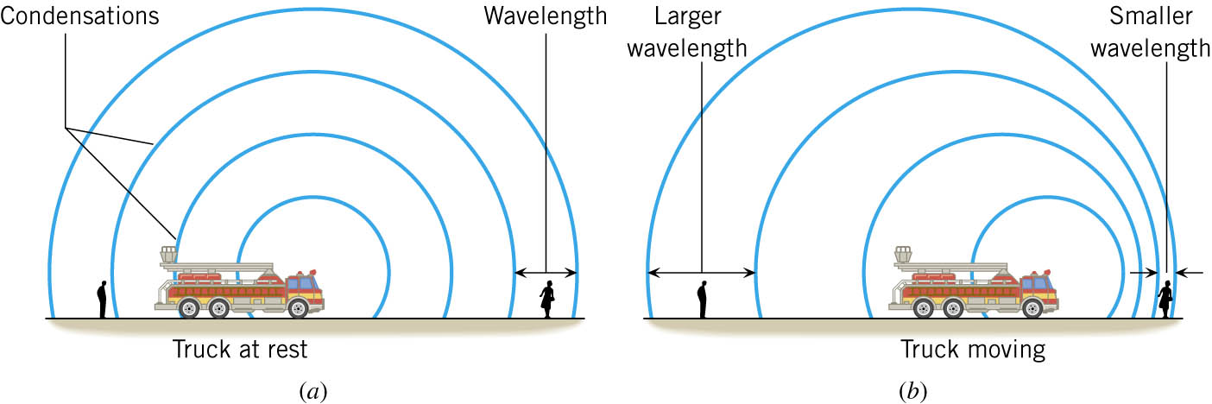
07-05 Doppler Effect
Notes:
When the truck is still, the sounds waves move outward in all the directions, the same speed

Slide 56
07-05 Doppler Effect
Notes:
When the truck is moving.
It produces a condensation, moves, produces another condensation, moves, etc.
Since it moves between condensations, they are closer together in front of the truck and farther apart behind the truck.
Higher freq (short λ) = higher pitch
Lower freq (long λ) = lower pitch

Slide 57
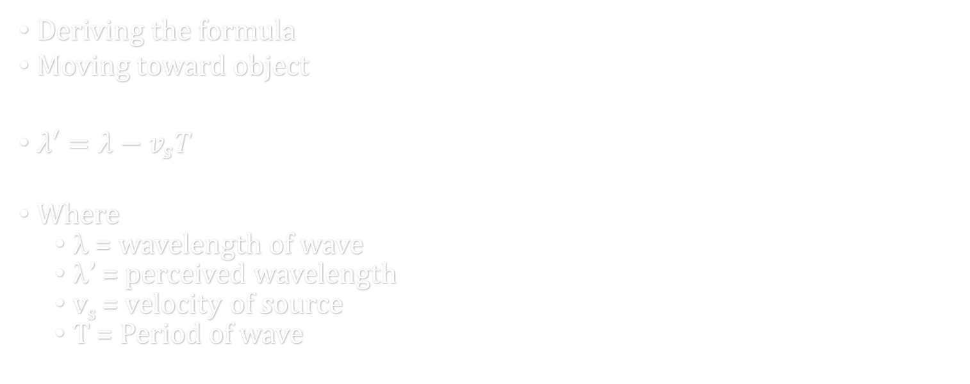
07-05 Doppler Effect
Deriving the formula
Moving toward object
$λ′=λ−v_{s}T$
Where
  λ = wavelength of wave
  λ’ = perceived wavelength
  v_{s} = velocity of source
  T = Period of wave
Notes:
The perceived wavelength is shorted by the distance the source moves in one period.
(Period is time between condensations)

Slide 58

07-05 Doppler Effect
$f_{o}=\frac{v_{w}}{λ^{′}}=\frac{v_{w}}{λ−v_{s}T}$
$λ=\frac{v_{w}}{f_{s}}$ $T=\frac{1}{f_{s}}$
$f_{o}=f_{s}\left(\frac{v_{w}}{v_{w}−v_{s}}\right)$
λ’ = perceived wavelength
f_{o} = frequency observed
f_{s} = frequency of source
v_{w} = speed of wave
v_{s} = speed of source

Slide 59

07-05 Doppler Effect
Moving Observer
Encounters more condensations than if standing still
$f_{o}=f_{s}\left(\frac{v_{w}+v_{o}}{v_{w}}\right)$
Notes:
Notice the differences between the two formulas

Slide 60

07-05 Doppler Effect
General Case
Combine the two formulas
Both observer and source can be moving
WARNING!
  v_{w}, v_{s}, and v_{o} are signless
  Use the top signs when that object is moving towards the other object
$f_{o}=f_{s}\left(\frac{v_{w}±v_{o}}{v_{w}∓v_{s}}\right)$

Slide 61
07-05 Doppler Effect
You are driving down the road at 20 m/s when you approach a car going the other direction at 15 m/s with their radio playing loudly. If you hear a certain note at 600 Hz, what is the original frequency? (Assume speed of sound is 343 m/s)
542 Hz
Notes:
$$f_{o}=f_{s}\left(\frac{v_{w}±v_{o}}{v_{w}∓v_{s}}\right)$$
$$600 Hz=f_{s}\left(\frac{343\frac{m}{s}+20\frac{m}{s}}{343\frac{m}{s}−15\frac{m}{s}}\right)$$
$$600 Hz=f_{s}\left(1.1\right)$$
$$f_{s}=542 Hz$$

Slide 62
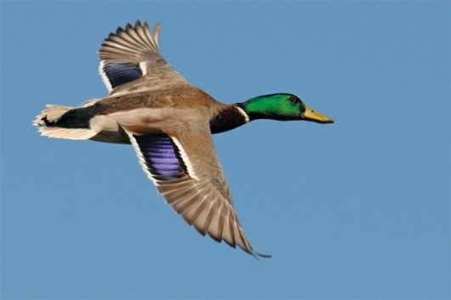
07-05 Doppler Effect
A duck is flying overhead while you stand still. As it moves away, you hear its quack at 190 Hz. Because you are a brilliant naturalist, you know that this type of duck quacks at 200 Hz. How fast is the duck flying?
18.1 m/s (40 mph)
Notes:
$$f_{o}=f_{s}\left(\frac{v_{w}±v_{o}}{v_{w}∓v_{s}}\right)$$
$$190 Hz=200 Hz\left(\frac{343\frac{m}{s}+0}{343\frac{m}{s}+v_{s}}\right)$$
$$65170 \frac{m}{s}+190 v_{s}=68600\frac{m}{s}$$
$$190 v_{s}=3430\frac{m}{s}$$
$$v_{s}=18.1\frac{m}{s}$$

Slide 63
07-05 Doppler Effect
NEXRAD
  NEXt generation weather RADar
  Sends out radio waves
  Wave bounce off water drops in storms
  Radar receives echoes
  Computer checks to compare the frequencies
  Can compute to see how fast the clouds are spinning
Notes:
Water on one side of tornado move away, water on other side move towards radar

Slide 64
07-05 Homework
Move yourselves to do these exercises
Read 16.10

Slide 65
07-06 Superposition and Interference
In this lesson you will…
• Explain standing waves.
• Describe the mathematical representation of overtones and beat frequency.

Slide 66
07-06 Lab
Do the 07-06 Superposition Lab

Slide 67
07-06 Superposition and Interference
Often two or more wave pulses move through the same space at once
When two or more waves are present simultaneously at the same place, the resultant disturbance is the sum of the disturbances from individual waves

Slide 68
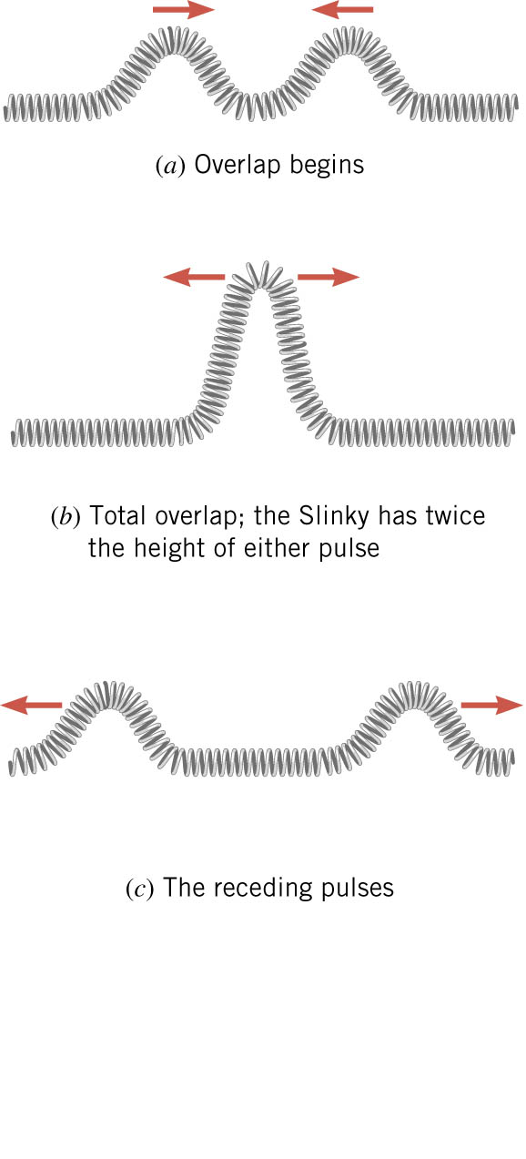
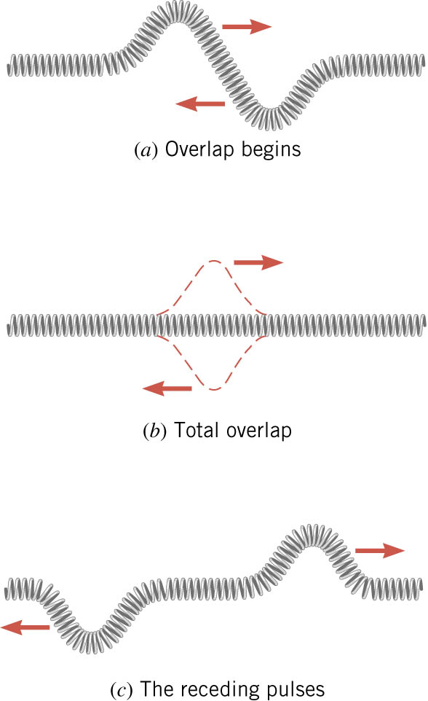
07-06 Superposition and Interference
Notes:
Try to demonstrate with spring or wave tank

Slide 69
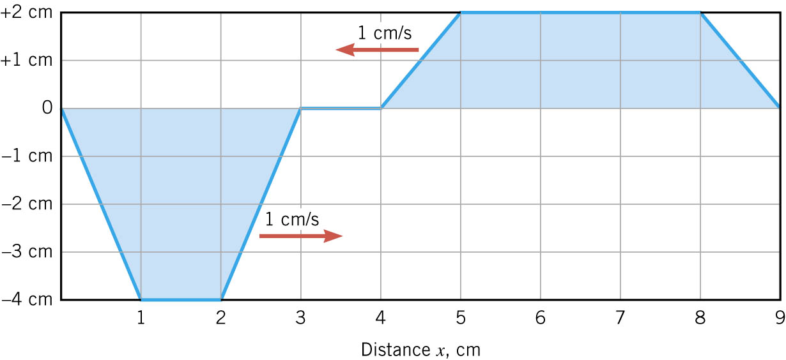
07-06 Superposition and Interference
After 2 seconds, what is the height of the resultant pulse at x = 2, 4, and 6 cm?
0, -2, 2
Notes:
Draw the result on the pull down graph

Slide 70
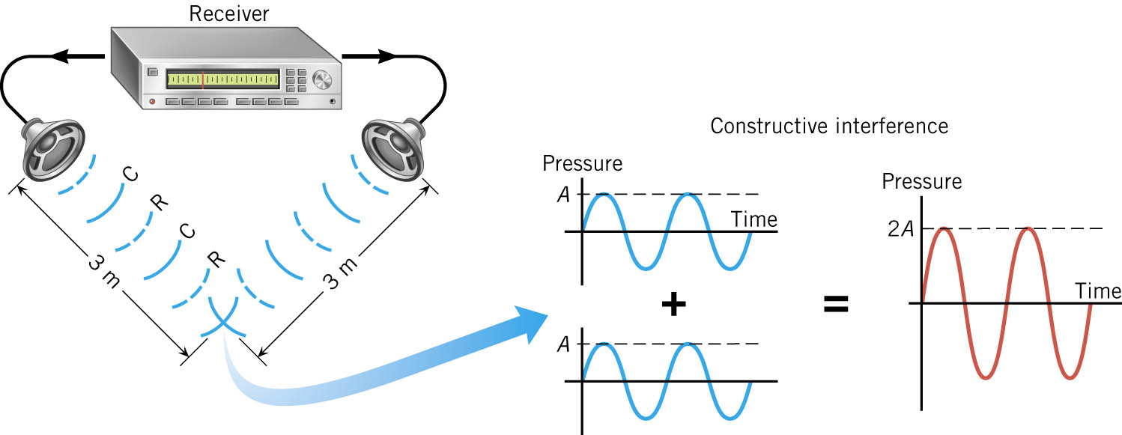
07-06 Superposition and Interference
Imagine that there are 2 speakers facing each other. Both speakers produce the same sound at the same time. λ = 1 m
Notes:
At a point between the speakers where each of the sounds have moved full wavelengths
Condensation meats condensation and rarefaction meets rarefaction all the time
Linear superposition says the sound is twice as loud
Called constructive interference (exactly in phase)

Slide 71
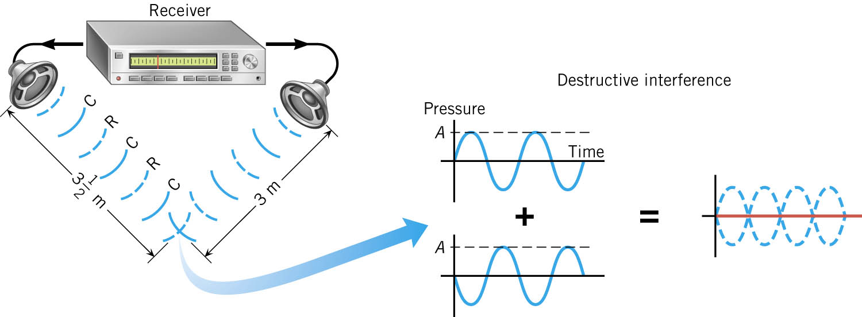
07-06 Superposition and Interference
One of the speakers is moved back half a wavelength
Notes:
Now a condensation always meets a rarefaction, so cancel into nothing
Called Destructive interference (exactly out of phase)

Slide 72
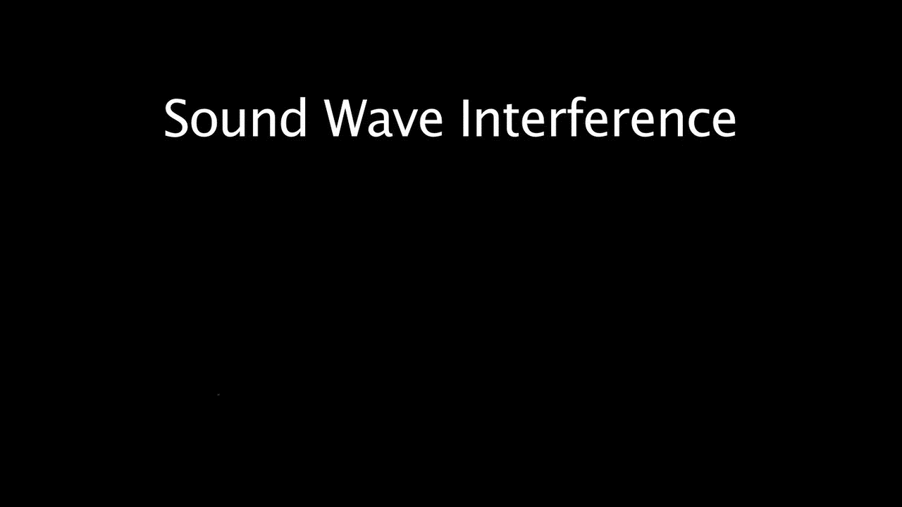
07-06 Superposition and Interference

Slide 73
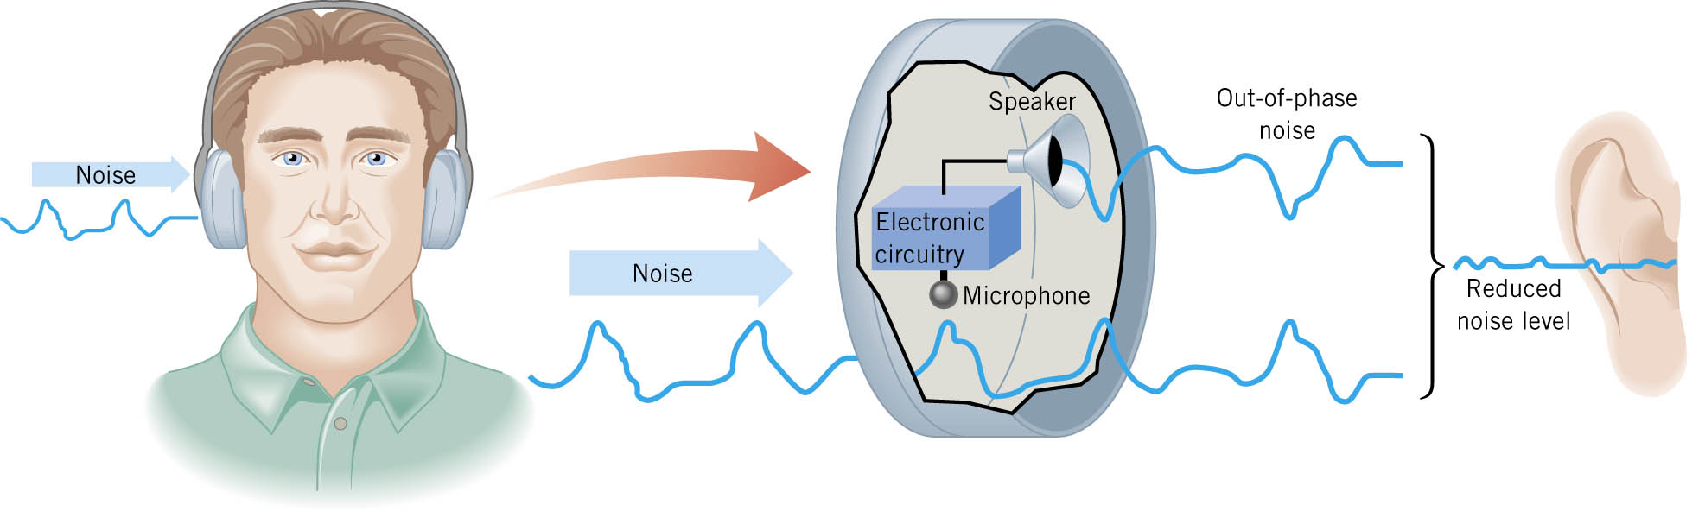
07-06 Superposition and Interference
Notes:
A microphone hears the noise
The electronics invert the noise
A speaker plays the inverted noise and destructive interference results so you don’t hear much

Slide 74
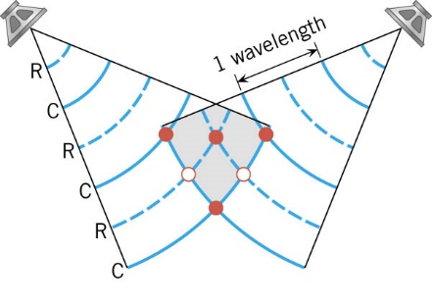
07-06 Superposition and Interference
Notes:
Solid lines are condensations, dashed lines are rarefactions
2 fixed speakers
where two condensations or rarefactions meet = constructive interference (red dots)
Where a condensation and rarefaction meet = destructive interference (white dots)
So as you move throughout the room the noise intensities change depending on your position
Follows law of conservation of energy
At constructive interference → twice as much energy
At destructive interference → no energy
Add it all up and you get constant energy (1 + 1 = 2 + 0)

Slide 75
07-06 Superposition and Interference
Beats
  When two frequencies are the same
  Constructive and Destructive Interference give twice the amplitude or no amplitude
  What if the two frequencies are just slightly different?

Slide 76
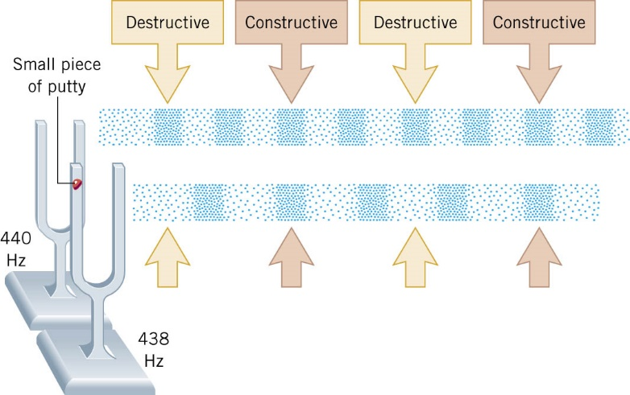
07-06 Superposition and Interference
Notes:
When the frequencies are slightly different, Constructive and destructive interference still happens
Where two condensations are at the same place, you get louder
Where 1 condensation and 1 rarefaction are at the same place, you get softer
You get some places with loud and some soft and in between

Slide 77
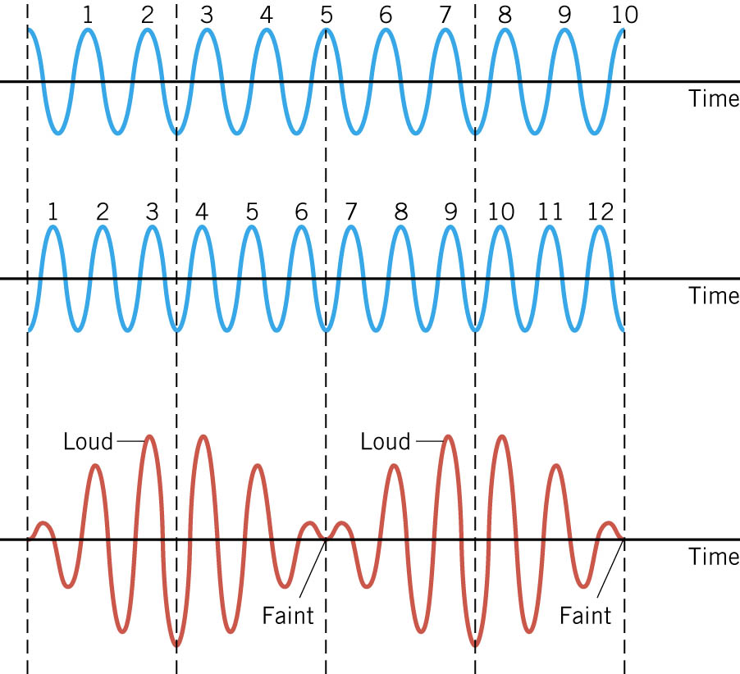
07-06 Superposition and Interference
Notes:
What the ear hears is the rising and falling of volume of the combined frequency
How often the loudness rises and falls is the beat frequency
Beat frequency obtained from subtracting the two frequencies of the sounds.
In the picture, the number above each blue wave indicates the number of complete cycles
The top wave is 10 Hz, the bottom is 12 Hz
The beat frequency is 12 – 10 = 2 Hz as seen in the red wave

Slide 78
07-06 Superposition and Interference
Beat Frequency = difference of the two source frequencies
Beats = | f₁ – f₂ |

Slide 79
07-06 Superposition and Interference
A simple way to tune musical instruments is with beats
If the notes are out of tune, you hear beats
Adjust the tuning and try again
If the frequency of the beats is higher, adjust the other way
Keep adjusting until there are no more beats

Slide 80
07-06 Superposition and Interference
Two car horns have an average frequency of 420 Hz and a beat frequency of 40 Hz. What are the frequencies of both horns?
440 Hz, 400 Hz
Notes:
$$f_{ave}=\frac{f_{1}+f_{2}}{2}$$
$$f_{B}=f_{1}−f_{2}$$
$$420 Hz=\frac{f_{1}+f_{2}}{2}$$
$$40 Hz=f_{1}−f_{2}$$
$$840 Hz=f_{1}+f_{2}$$
$$40 Hz=f_{1}−f_{2}$$
$$880 Hz=2f_{1}$$
$$f_{1}=440 Hz$$
$$f_{2}=400 Hz$$

Slide 81
07-06 Homework
Don’t beat around the bush, start the problems now!
Read 17.5

Slide 82
07-07 Sound Interference and Resonance
In this lesson you will…
• Define antinode, node, fundamental, overtones, and harmonics.
• Identify instances of sound interference in everyday situations.
• Describe how sound interference occurring inside open and closed tubes changes the characteristics of the sound, and how this applies to sounds produced by musical instruments.
• Calculate the length of a tube using sound wave measurements.

Slide 83
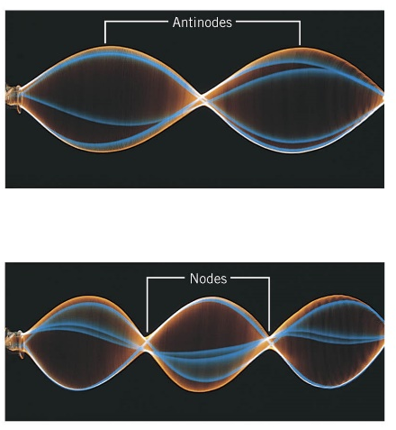
07-07 Sound Interference and Resonance
One end of a string is attached to a fixed point.
The other end is vibrated up and down.
The standing wave is formed.
Nodes – No move
Antinodes – most movement

Slide 84
07-07 Sound Interference and Resonance
The wave travels along the string until it hits the other end
The wave reflects off the other end and travels in the opposite direction, but upside down
The returning wave hits the vibrating end and reflects again (this side the wave is right side up)
Unless the timing is just right the reflecting wave and the new wave will not coincide
When they do coincide, the waves add due to constructive interference
When they don’t coincide; destructive interference
Notes:
Why its reflected upside down. → the string pulls up on the wall, by Newton’s reaction force, the wall pulls down on the string

Slide 85
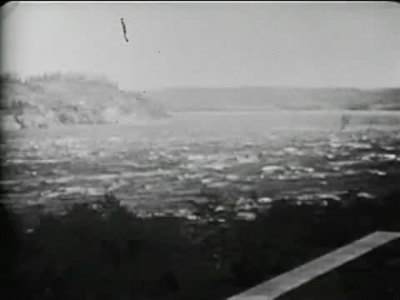

Slide 86
07-07 Sound Interference and Resonance
Harmonics
  When you vibrate the string faster, you can get standing waves with more nodes and antinodes
  Standing waves are named by number of antinodes
    1 antinode → 1st harmonic (fundamental freq)
    2 antinodes → 2nd harmonic (1st overtone)
    3 antinodes → 3rd harmonic (2nd overtone)

Slide 87
07-07 Sound Interference and Resonance
f₁ = fundamental frequency (1st harmonic)
f₂ = 2f₁ (2nd harmonic)
f₃ = 3f₁ (3rd harmonic)
Harmonics Example
  If the fundamental is 440 Hz (concert A)
  2nd harmonic = 2(440 Hz) = 880 Hz (High A)
  3rd harmonic = 3(440 Hz) = 1320 Hz
Notes:
Multiply the fundamental frequency by an integer to obtain that integer’s harmonic

Slide 88
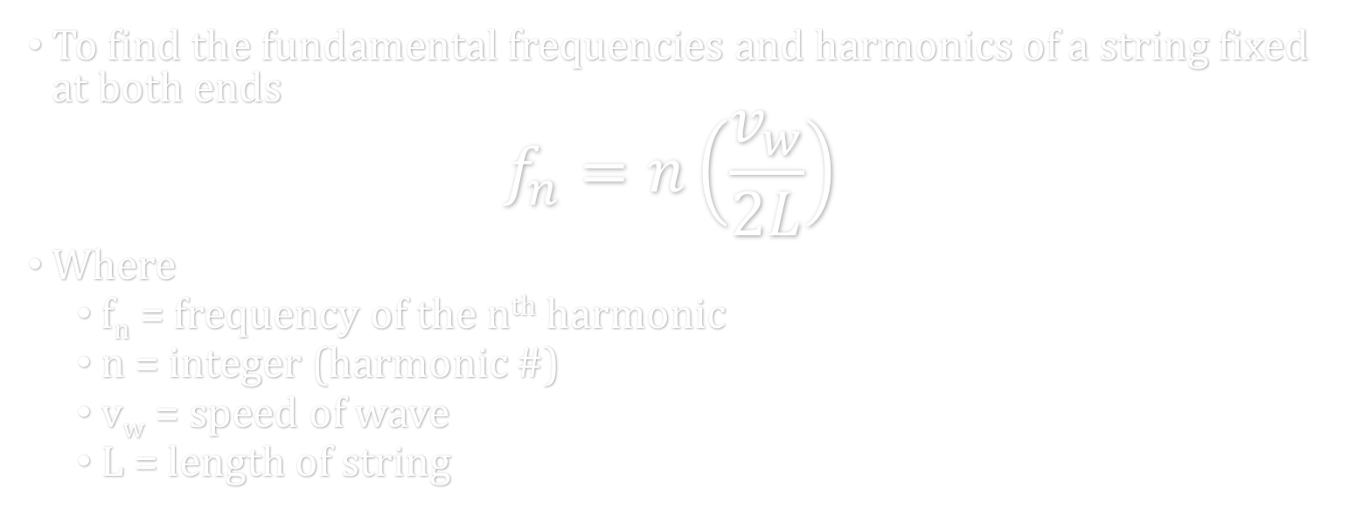
07-07 Sound Interference and Resonance
To find the fundamental frequencies and harmonics of a string fixed at both ends
$$f_{n}=n\left(\frac{v_{w}}{2L}\right)$$
Where
  f_{n} = frequency of the n^{th} harmonic
  n = integer (harmonic #)
  v_{w} = speed of wave
  L = length of string

Slide 89
07-07 Sound Interference and Resonance
Just like stringed instruments rely on standing transverse waves on strings
Wind instruments rely on standing longitudinal sound waves in tubes
The waves reflect off the open ends of tubes
One difference at the ends are antinodes instead of nodes
Notes:
Demonstrate antinodes at the end by making standing waves in a string by dangling a string and shaking it

Slide 90
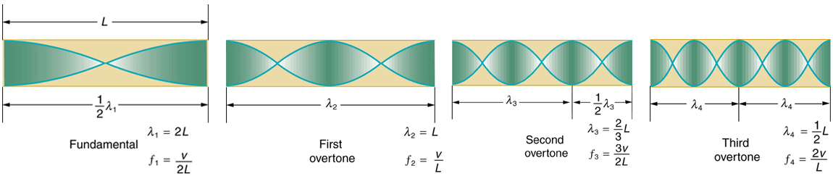
07-07 Sound Interference and Resonance
Tube open at both ends

Slide 91

07-07 Sound Interference and Resonance
Formula for Tube Open at Both Ends
  Distance between antinodes = ½ λ
  Tube must be integer number of ½ λ
    $L=n\left(\frac{1}{2}λn\right)$ or $n=\frac{2L}{n}$
  $fn=\frac{v_{w}}{λn}$
  $$f_{n}=n\left(\frac{v_{w}}{2L}\right)$$
Notes:
Demonstrate with tube

Slide 92
07-07 Sound Interference and Resonance
What is the lowest frequency playable by a flute that is 0.60 m long if that air is 20 °C.
f = 285.8 Hz
Notes:
$$n = 1$$
$$f = 1\left(\frac{343\frac{m}{s}}{2\left(.6 m\right)}\right) = 285.8 Hz$$

Slide 93

07-07 Sound Interference and Resonance
Tube open at one end

Slide 94

07-07 Sound Interference and Resonance
Tube Open at One End
  Node at the closed end
  Antinode at the open end
  At fundamental frequency L = ¼ λ
  The 2nd harmonic adds one more node or ½ λ
  Thus the lengths are odd integer multiples of ¼ λ
  $$f_{n}=n\left(\frac{v_{w}}{4L}\right)$$
  Only odd harmonics
Notes:
Where n is odd integers

Slide 95
07-07 Homework
Try blowing your way through these problems
Read 17.6, 17.7

Slide 96
07-08 Hearing and Ultrasound
In this lesson you will…
• Define hearing, pitch, loudness, timbre, note, tone, phon, ultrasound, and infrasound.
• Compare loudness to frequency and intensity of a sound.
• Identify structures of the inner ear and explain how they relate to sound perception.
• Define acoustic impedance and intensity reflection coefficient.
• Describe medical and other uses of ultrasound technology.
• Calculate acoustic impedance using density values and the speed of ultrasound.

Slide 97
07-08 Hearing and Ultrasound
Hearing
  Pitch
    Perception of frequency
    20 Hz – 20000 Hz
    Most sensitive to 2000 – 5000 Hz
    Can distinguish between pitches that vary by at least 0.3 %
Loudness
  Perception of intensity
  Range 10⁻¹² W/m² – 10¹² W/m²
  Most people can discern a intensity level difference of 3 dB

Slide 98
07-08 Hearing and Ultrasound
Phons measure loudness
The graph shows the sensitivity of the average human ear

Slide 99

07-08 Hearing and Ultrasound
Ultrasound
Used in obstetrics to examine a fetus, used to examine some organs, and blood flow
High frequency sound aimed at target
Sound reflects at boundary of tissues with different acoustic impedances
Computer compiles picture from where echoes come from
Acoustic impedance
$$Z=ρv$$
  See table 17.5
Intensity reflection coefficient
$$a=\frac{{\left(Z_{2}−Z_{1}\right)}^{2}}{{\left(Z_{1}+Z_{2}\right)}^{2}}$$
  Higher coefficient, more reflection
Can’t see detail smaller than $λ$
Can only penetrate to depth of 500$λ$

Slide 100
07-08 Hearing and Ultrasound
Calculate the intensity reflection coefficient of ultrasound when going from water to fat tissue (like a baby in the womb).
a = 0.00317
This means 0.317% of the sound is reflected.
Notes:
$$a=\frac{{\left(Z_{2}−Z_{1}\right)}^{2}}{{\left(Z_{1}+Z_{2}\right)}^{2}}$$
$$a=\frac{{\left(1.5×{10}^{6}\frac{kg}{m^{2}⋅s}−1.34×{10}^{6}\frac{kg}{m^{2}⋅s}\right)}^{2}}{{\left(1.5×{10}^{6}\frac{kg}{m^{2}⋅s}+1.34×{10}^{6}\frac{kg}{m^{2}⋅s}\right)}^{2}}=0.00317$$

Slide 101
07-08 Hearing and Ultrasound
Cavitron Ultra Surgical Aspirator
Used to remove inoperable brain tumors
Tip of instrument vibrates at 23 kHz
Shatters tumor tissue that comes in contact
Better precision than a knife

Slide 102
07-08 Hearing and Ultrasound
High-Intensity Focused Ultrasound
Sound is focused on a region of the body.
The waves entering the body don’t do damage
Only damage done where focused (like sun and magnifying glass)
The focused energy at target causes heating which kills abnormal cells

Slide 103
07-08 Hearing and Ultrasound
Doppler Flow Meter
Transmitter and receiver placed on skin
High frequency sound emitted
Sound reflects off of blood cells
Since cells are moving, Doppler effect exists
Computer can find rate of flow by counting the returned frequency
Used to find areas of narrowed blood vessels
Narrowest area → fastest flow

Slide 104
07-08 Homework
Applying science is called engineering.

